Slide 1
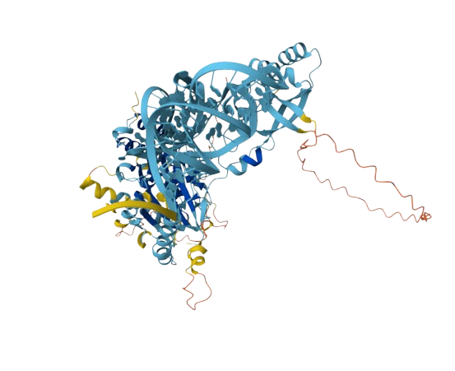
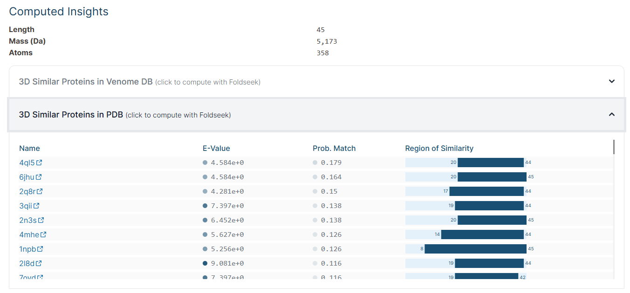
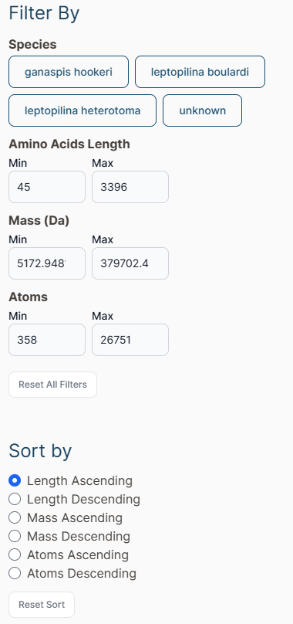
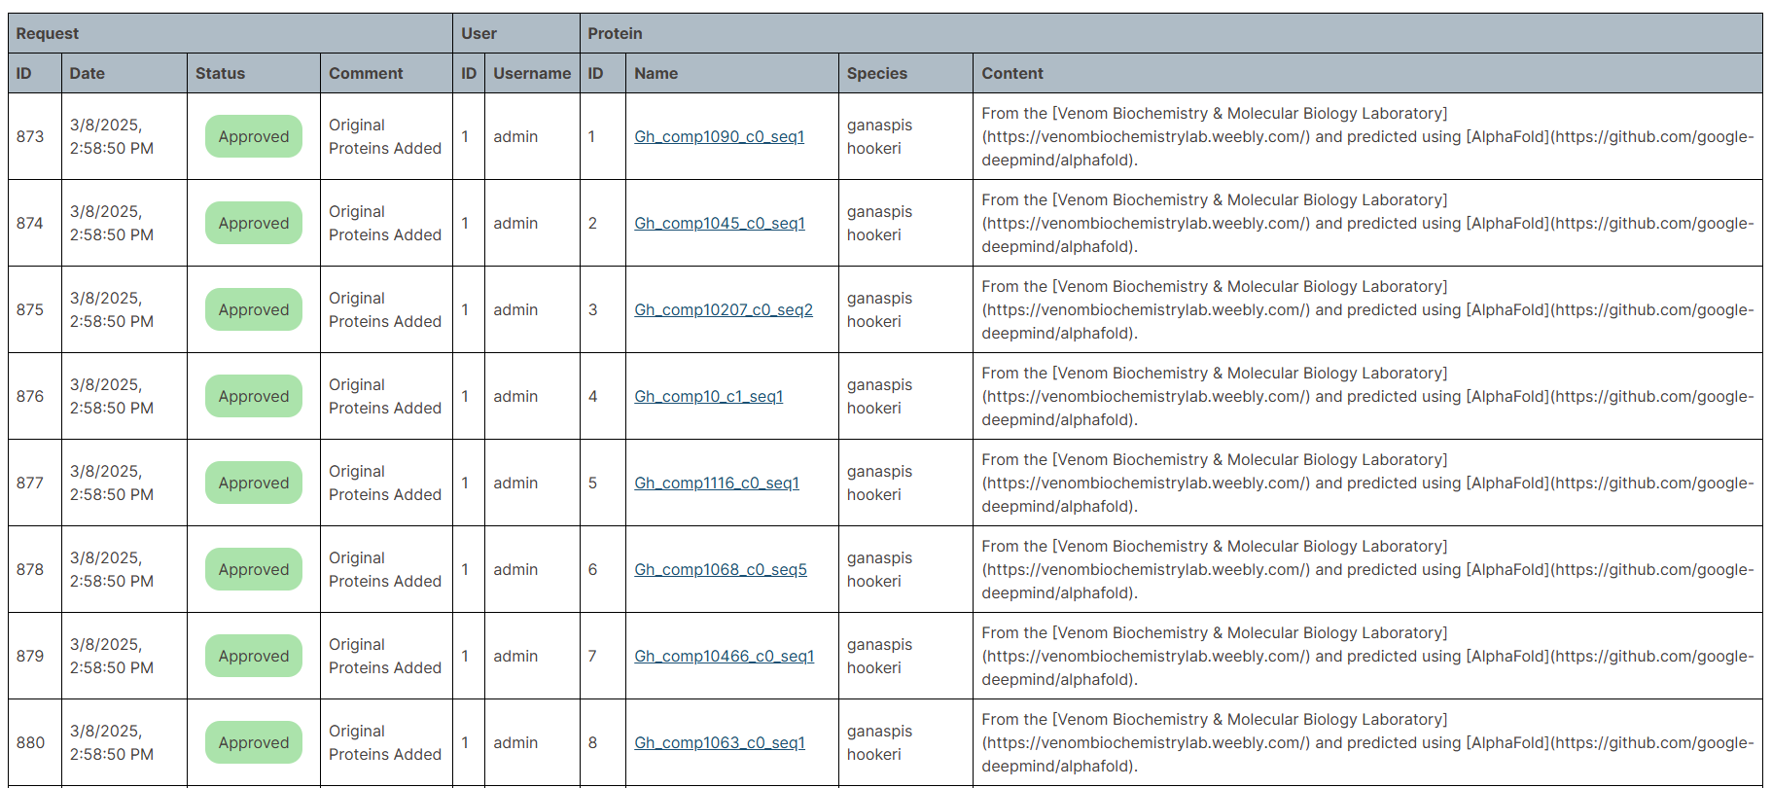

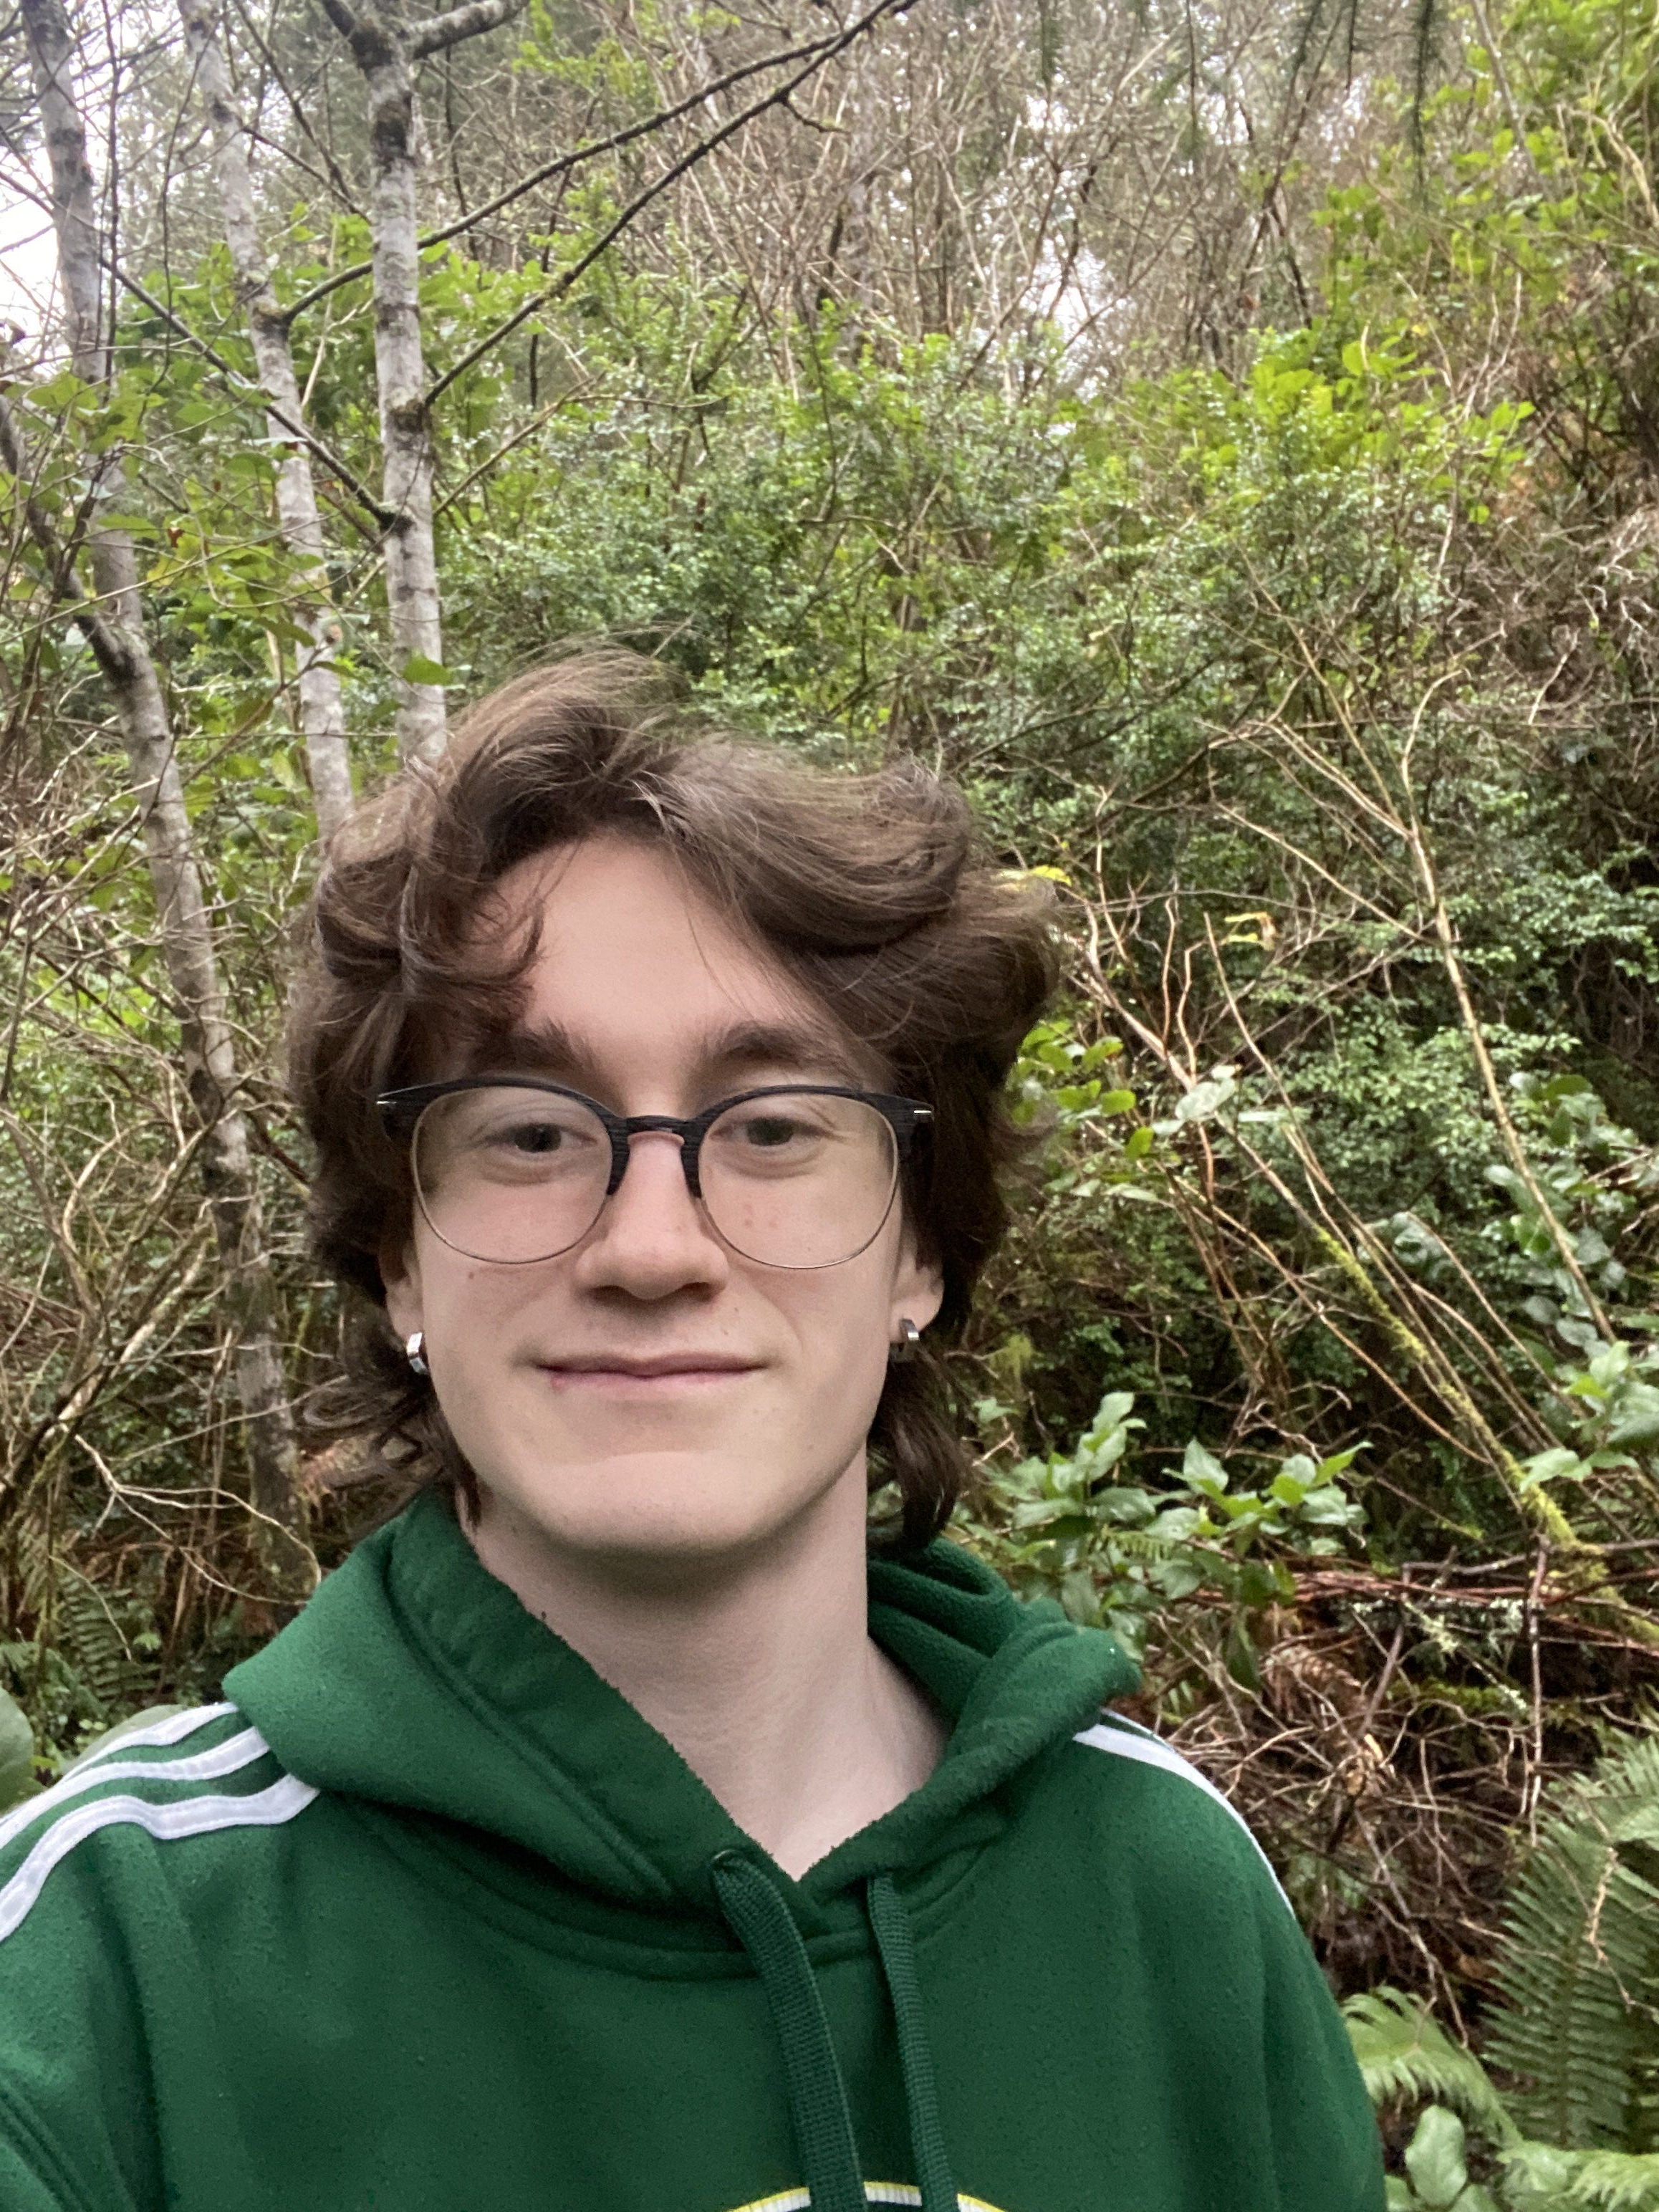
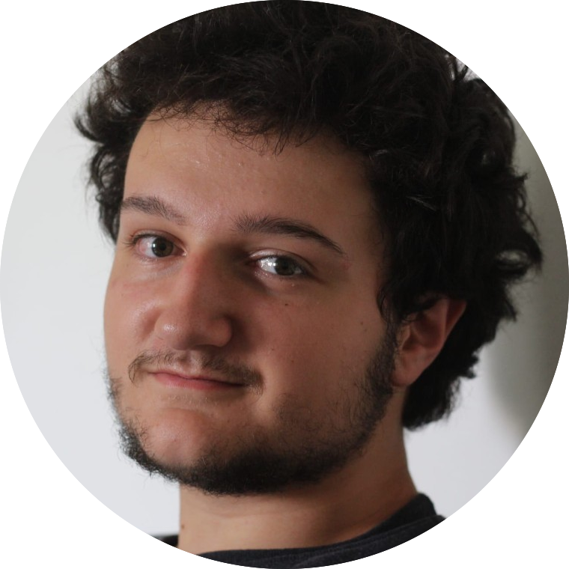
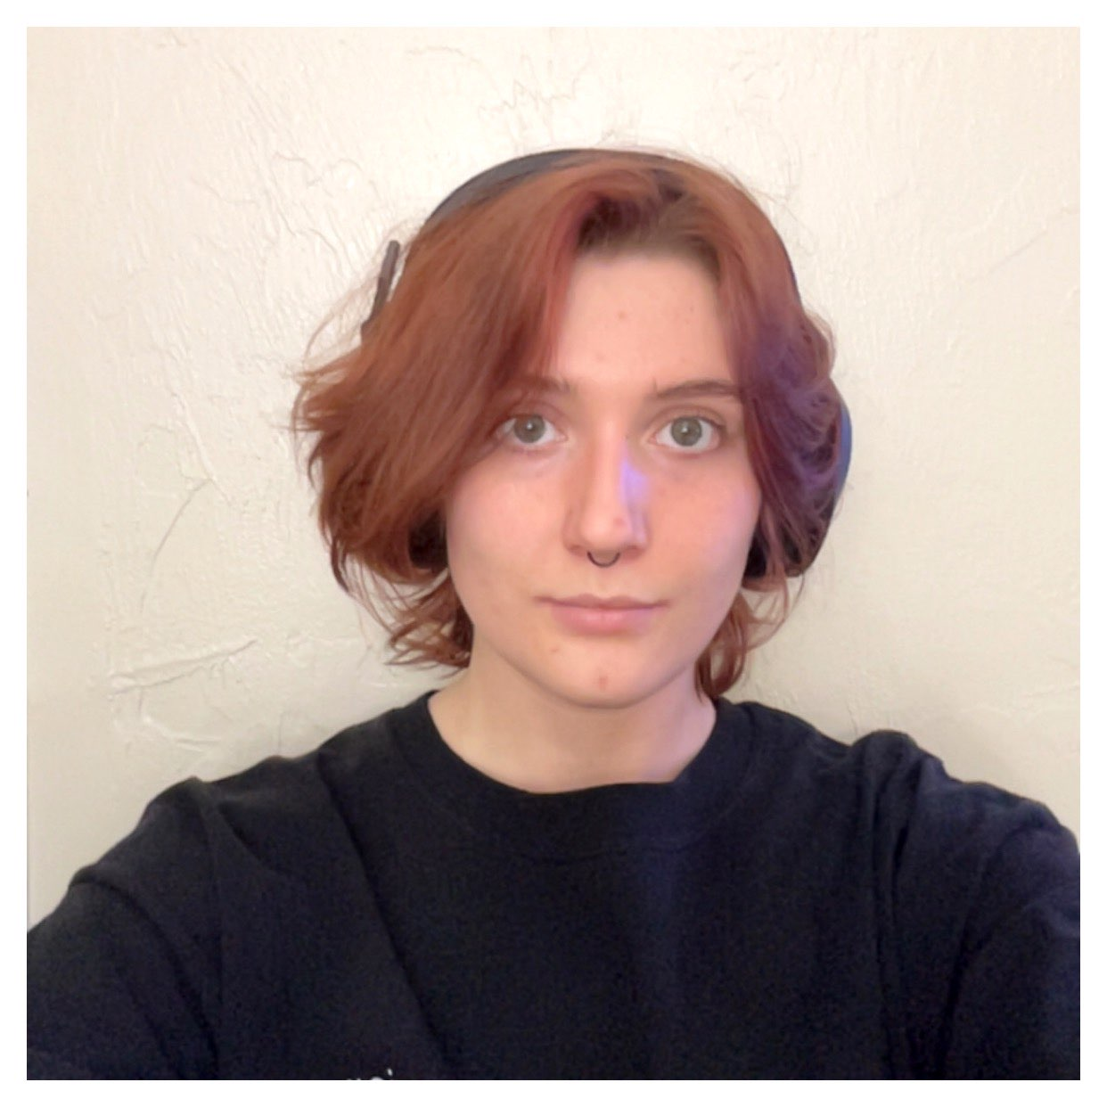


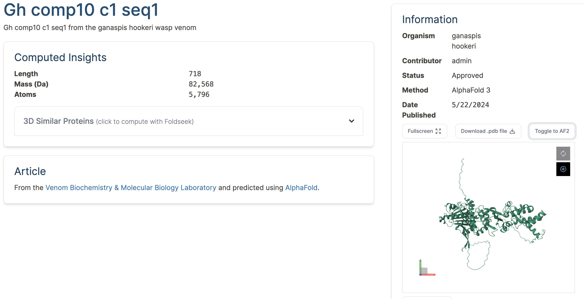
CS.034
The Wikipedia of venomE
The unknown Venome
Where it Started
Researchers at OSU's Venome Biochemistry Lab (Venom Lab) needed a way to store, compare, analyze, and share their sequenced venom proteins.
Last year's capstone team created a public-facing website to share articles and protein prediction models, with a database of over 400 proteins sequences which can be searched or filtered, and integration of visualization tools Mol*, Foldseek, and TM-Align.
Features
This year, we focused on improving user experience and expanding features for website management.
PDB Comparisons – The Protein Database is the largest database of proteins on the internet. We integrated the ability to find patterns between our and their proteins.
User account creation – Users can create their own accounts, which are automatically added to our user database. We also added an "admin" type of accounts that can approve protein sequences uploaded by users.
User-uploaded proteins – Users can upload proteins, which are added to the website and database if approved. Users can see who uploaded a protein, and each user has a collection of proteins they have uploaded.
Articles – These articles give other users a chance to learn more about research being performed around the country at other labs.
Search and Filter Expansion – We decided it would help users search through the large database if they had the ability to sort by different attributes, and search based on atom count.
AlphaFold3 – In May 2024, Google DeepMind's AlphaFold3 was released. In November, it became available for for community use. Our website now supports visual comparison and storage between AlphaFold2 and AlphaFold3 predictions.
Where do we go from here?
Future prepping our project is our big goal for now. Another team will likely be taking on this project next year, so we want to make sure they have as many resources as possible.
A Website to Connect Biochemists Across the Country, Designed for Research and Sharing
Meet the venome team
Figure 1. Comparisons and Computed Insights
Capstone Group
Jace Bolante
Chase Copeland
Alex Clark
Megan Dorn
Alex Holly
Ethan Peterson
OSU Venome Biochemistry Lab
Dr. Nathan Mortimer
Michael Youkhateh
With Contributions From
The PDB team
Google Deepmind
Special Thanks To
Cora Balley, Donald Bertucci,
Ansen Garvin, Amanda Sinha
Max Nickila
Figure 2. User Submission Requests
Figure 3. Filter Functions
Visualize, Compare, Store
The goal to enable biochemists to learn and contribute to the venom protein database is accomplished in a few main steps within this site. Users can upload their proteins (Fig 2), Search and filter proteins (Fig 3), visualize and analyze proteins and their 3D structures (Fig 4), compare between protein models (Fig 1).
Figure 4. Protein view page including AlphaFold 3

